Slide 1
Shell Scripting
By Steve Nyasimi

Slide 2


What is Shell scripting ?
For that, we’ll first need to know what a shell is.
There are different types of shells, such as
The Philly Shell
Linux command line

Slide 3
The Shell
The Unix Shell is a command line user interface between the user and the operating system. It server both as an command interpreter and a programming language
In simple terms, The shell is what you type stuff into and everyone in the cafe thinks you’re a hacking them.

Slide 4
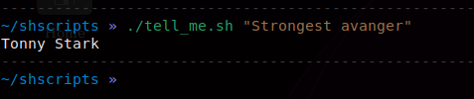
The shell
Below is an example of how the shell works
You type in commands
The OS/Kernel executes if for you
You get output

Slide 5
Shell Scripting
A Shell script is a file containing shell commands, These commands can be written in such a way that if run them in a terminal/shell, you can achieve a desired goal or solve a specific repetitive issue. Just like software :)

Slide 6
Why we need it
As you have seen, the shell allows us to type commands and give it arguments, now say we had one like this
cat /var/log/auth.log.1 /var/log/auth.log | grep -e 'auth\|authentication\|root\|Failed password'
Long.

Slide 7
Now, let’s say we needed to filter the input repeatedly to get our desired result, which os to get all failed password attempts for the sudo user
Our command mutates to
$ cat /var/log/auth.log.1 /var/log/auth.log | grep -e 'auth\|authentication\|root\|Failed password' | grep "sudo"

Slide 8
There’s more
More????
Yes.
cat /var/log/auth.log.1 /var/log/auth.log | grep -e 'auth\|authentication\|root\|Failed password' | grep "sudo" | grep -i "COMMAND"

Slide 9
Bruh, you know what…

Slide 10
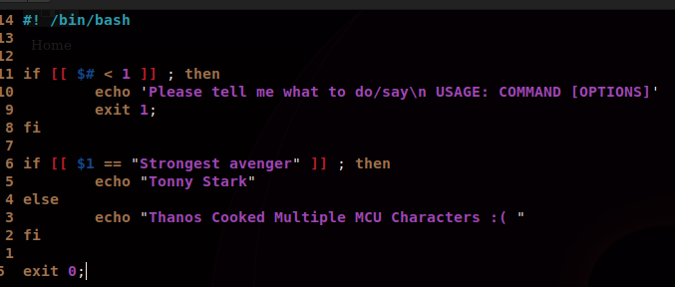
Structure of a shell script

Slide 11
Structure of a shell script
What is
“/#! /bin/bash”
?

Slide 12
Structure of a shell script
Bash’s The scripting language allows for the following control structures
Input & vars
Example code can be found here
If..statements
Example can be found here
If…else (elif)
Examples code can be found here
Switch case statements
Example code can be found here
For, while and until loops
Example code can be found here
Break, continue, exit and return
Example code can be found here
Feel free to check out the repo, if you want to modify the game, feel free.

Slide 13
Features of a shell script
Some of its features also include
String manipulation and operations
Example can be found here
Arithmentic operations
Examples can be found here
File operations
Examples can be found here
Functions
Examples can be found here
Script parameters
Enviromental variables
Can be set to run automatically using cronjobs

Slide 14
Our original command, but with a little magic
We can create a script that extracts and reads all the log files, filters the output and saves it to a file and add a few modifications to it to include any compressed file

Slide 15
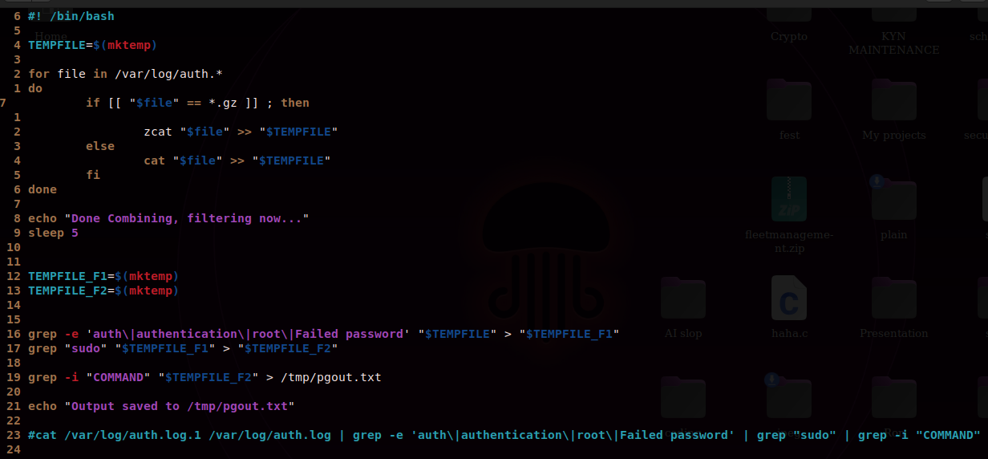

Slide 16
A game using shell script
The buggy land game, it’s an adventure game.
Where the number of steps you take determine your story.
Nuff chat, lets debug…
Here’s the game
Rules
Can move forward when out come of dice is an even number
Cannot play more than 4 times
Even numbers have consequences, some deduct 25% health others 12.5%
Win on 10>

Slide 17

End
Thank you for listening to my presentation

